Slide 1
THE MOTHER
OF ALL
MOTHER’S DAY
MESSAGES

Slide 2
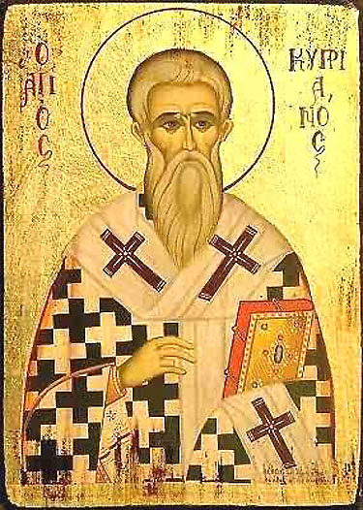
“You cannot have God for your Father unless you have the Church for your Mother.”
Cyprian of Carthage

Slide 3
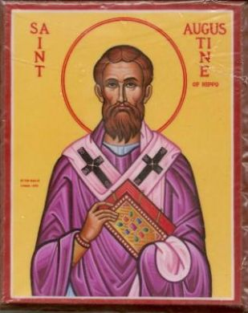
“The Church is really the Mother of Christians.”
St Augustine

Slide 4
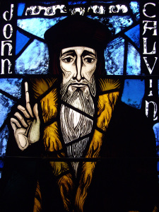
“The Church as the Mother of all Christians.”
John Calvin

Slide 5
“The Church as the Mother of all Christians.” John Calvin
The Church:
conceives
gives birth
nourishes
provides care & guidance
is the agent of forgiveness and salvation
cultivates godliness and piety

Slide 6
“… it is also our mission to go forth and share in the maternity of the church by bringing others to a life of faith. And so we ask ourselves, do we love the Church as our Mother, who helps us to grow as Christians? And how do we go beyond ourselves in order to bring Christ to others? As faithful children, let us bring the light of Christ to the ends of the earth …”
Pope Francis

Slide 7
“The work of the Holy Spirit renders her (the Church) fecund.”
Pope Francis

Slide 8
Fecund adj.
… producing or capable of producing offspring in abundance, prolific, fruitful, very productive.

Slide 9
Sarah (Genesis 11-23)
A personal revelation from God.

Slide 10
Rachel (Genesis 29-35)
A desperate passion.

Slide 11
Hannah (1 Samuel 1-2)
A desperate passion.

Slide 12
1 Samuel 1:15-19
Hannah said, “Oh no, sir—please! I’m a woman hard used. I haven’t been drinking. Not a drop of wine or beer. The only thing I’ve been pouring out is my heart, pouring it out to God. Don’t for a minute think I’m a bad woman. It’s because I’m so desperately unhappy and in such pain that I’ve stayed here so long.”
Eli answered her, “Go in peace. And may the God of Israel give you what you have asked of him.”

Slide 13
1 Samuel 1:15-19
“Think well of me—and pray for me!” she said, and went her way. Then she ate heartily, her face radiant.
Up before dawn, they worshiped God and returned home to Ramah. Elkanah slept with Hannah his wife, and God began making the necessary arrangements in response to what she had asked.

Slide 14
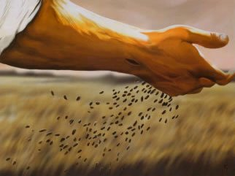
Luke 8:5-15
“A farmer went out to sow his seed.”

Slide 15
Our response:
By this time next year …
Ask
Sow
Trust the Lord to make the necessary arrangements in response to what we ask for!

